Slide 1
Lab 5: drawing and output
User Interface Lab: GUI Lab
Sep. 25th, 2013

Slide 2
Lab 5 goals
Review of some Programming Concepts
Ascii code
Creating New UIComponents
Triangle, circle, smiley face
External Classes and Interfaces

Slide 3
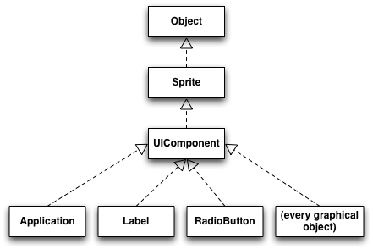

Slide 4
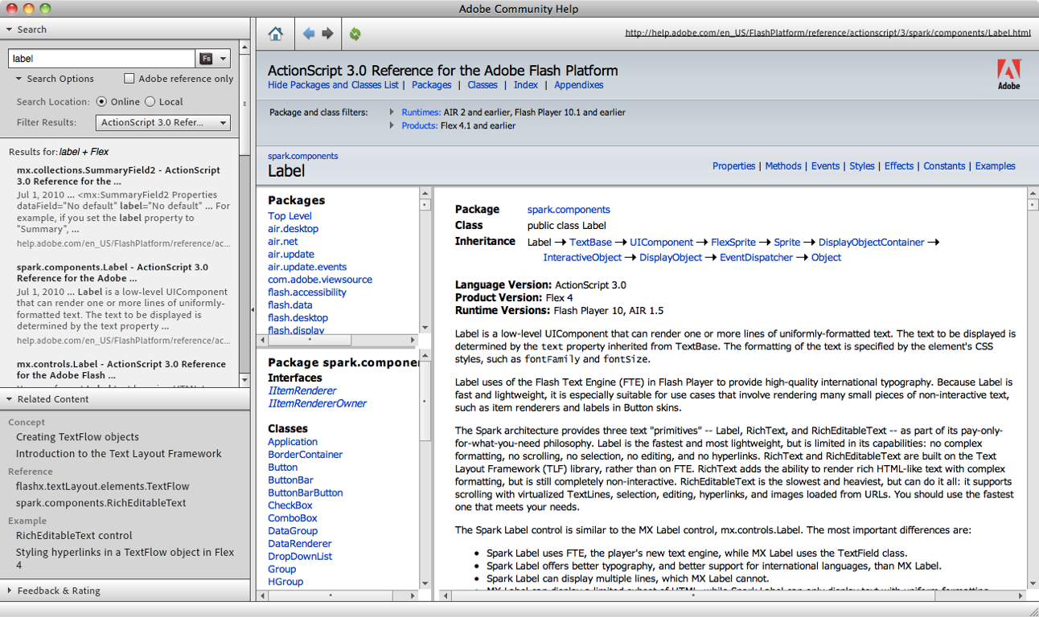

Slide 6
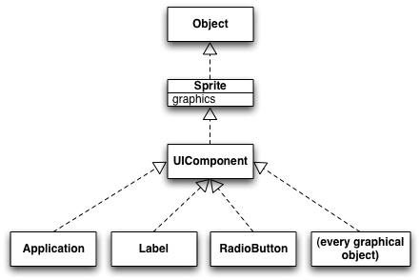

Slide 8
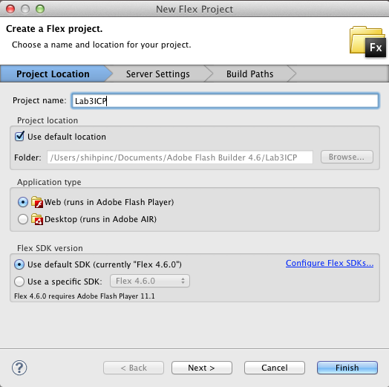
Create a new flex project
File -> New -> Flex project
Name: Lab5ICP
Click “Finish”
Enter source view

Slide 9
Interface
An abstract type that used to specify an interface that classes must implement.
Only contains method signature (in Flex).
function addOne(x:int):int;
What the function actually does is written in the class that implements the interface.
A typical use case: communication
“Here’s the requirement of this class…”

Slide 10
Create an actionscript interface
File -> New -> Actionscript Interface
Name it “IGUI_Shape”
Suppose we want all our shape classes to have two functions: draw():void and getName():String
Declare them in the interface
function draw():void;
function getName():String;

Slide 11
Create an actionscript class “GUI_Rectangle”
extends UIComponent
implements IGUI_Shape
Constructor:
Control+Space to auto-import
super();
addEventListener(FlexEvent.CREATION_COMPLETE, function(event:FlexEvent):void { draw();
});

Slide 12
Create an actionscript class “GUI_Rectangle”
Declare a public function draw():void (width & height inherited)
Declare a public function getName():String that returns “Rectangle”
graphics.beginFill(0x000000);
graphics.drawRect(0, 0, width, height);
graphics.endFill();

Slide 13
Add a GUI_Rectangle to the mxml
First, declare a VGroup as the parent object
<local:GUI_Rectangle …>
Because the class is in the default package
Set width and height both to 100

Slide 14
graphics class methods
beginFill(color, opacity): start drawing shape
moveTo(x,y): move drawing position
lineTo(x,y): move drawing position & draw
endFill(): fills shape drawn with color

Slide 15
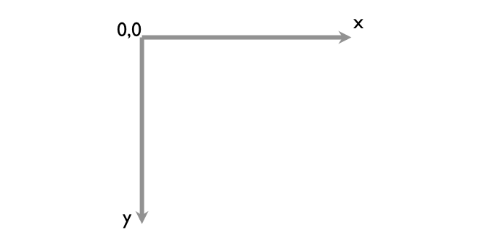
Drawing coordinates

Slide 16
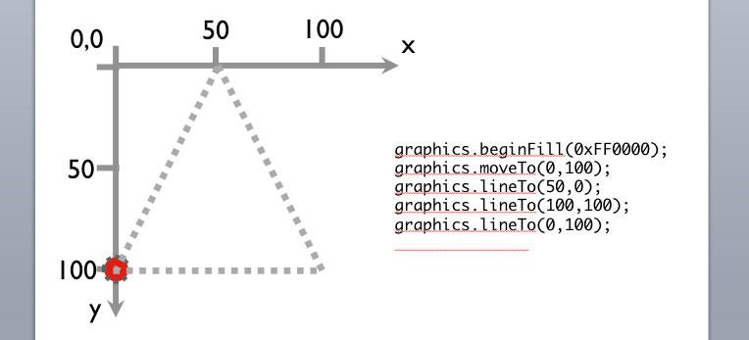
Drawing coordinates

Slide 17
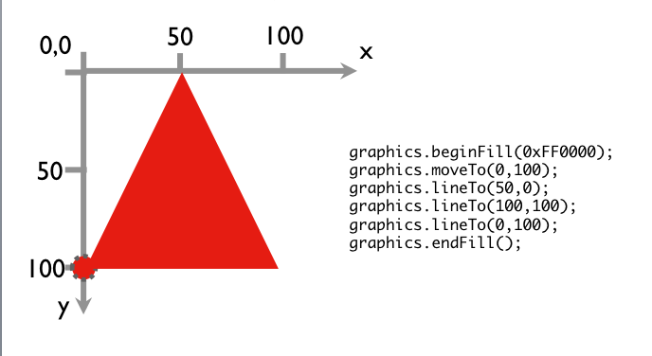
Drawing coordinates

Slide 18
Create an actionscript class “GUI_Triangle”
extends UIComponent implements IGUI_Shape
Constructor: same as GUI_Rectangle
Declare a public function getName():String that returns “Triangle”
Declare a public function draw():void that draws a red triangle (0, height), (width, height), (width/2, 0)

Slide 19
Add a GUI_Triangle to the mxml
Put it inside <VGroup>

Slide 20
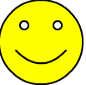
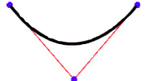
Create a GUI_Smiley class
extends UIComponent implements IGUI_Shape
Constructor: Same
getName: return “Smiley”’
Stroke size 2: graphics.lineStyle(2);
Yellow: 0xFFFF00
Face: center (x, y), radius = 50
Eyes: center (x-r/2, y-r/2)&(x+r/2,y-r/2), r=r/10
Smile: Curve
graphics.moveTo(x-r/2,y+r/2);
graphics.curveTo(x, y+r,x+r/2, y+r/2);

Slide 21
Add a GUI_Smiley to the mxml
Same way (w&h: 100x100)
What if most of the time, I want my GUI_Smiley to have a label below it showing its name?
I’ll drag a label every time when I add a smiley face.
I’ll create a MXML component that contains a smiley face and a label and add that component to the main mxml.

Slide 22
Create a MXML component “Smiley_and_Label”
File -> New -> MXML Component
Based on spark.components.VGroup
The root object will be a Vgroup
Put a label and a GUI_Smiley in the MXML
Add the component to your main mxml file (100x120).

Slide 23
FlexEvent.CREATION_COMPLETE
Fires when all objects in the application finished layout.
Remember to assign a width and height to the object in MXML files, so it can be drawn in the right place.

Slide 24
Next time: Events & input

